Slide 1
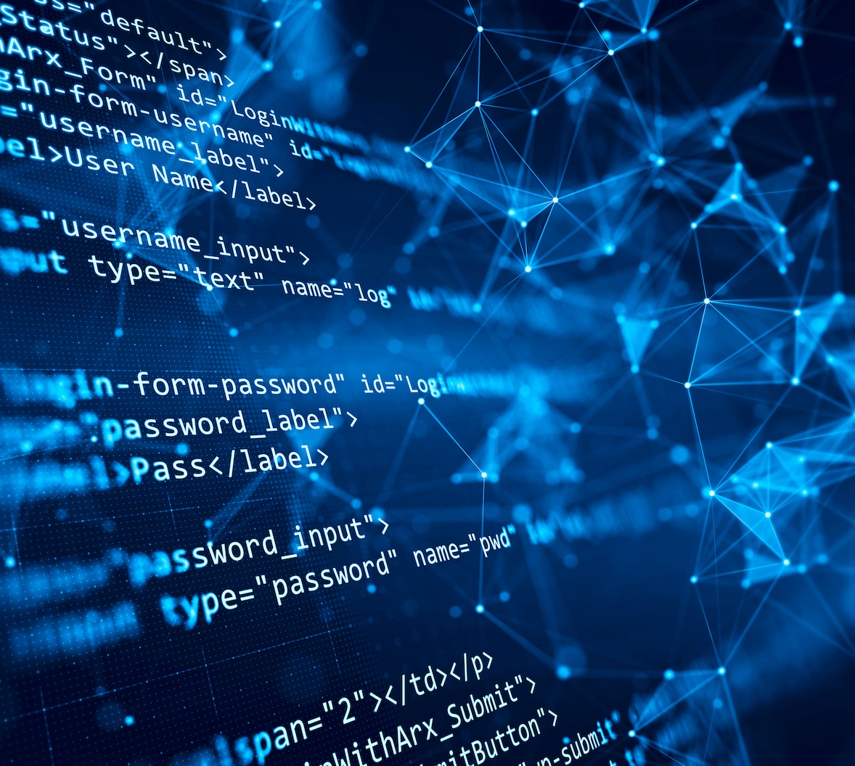

Research Lab Inventory Tracker Lizzett Tapia Sumedha Bhattacharyaa Jonathan Moore Evan Ross
TA & Sponsor: Shima Hasanpour

Slide 2
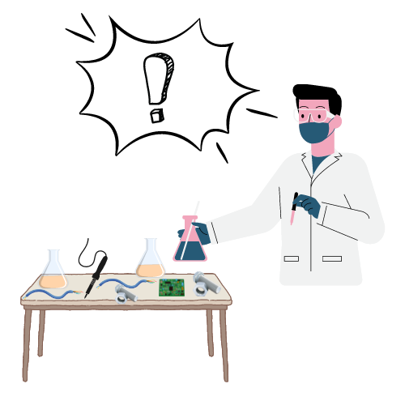
Problem Statement
“The current lab inventory tracking systems at Texas A&M are inefficient, and it is necessary to create new, organized software to increase the overall performance and efficiency of the Lab.”

Slide 3
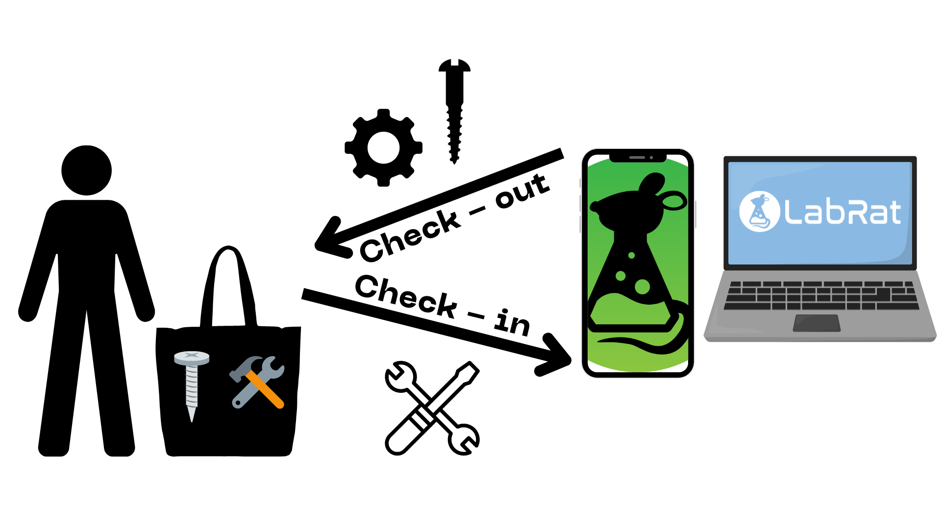
Solution Proposal
“Create a Web app and Mobile counterpart that interact with a database, so that the inventory items of TAMU labs can be intuitively identified, tracked, and altered.”

Slide 4
Interaction of Subsystems
Database
Web-App
Mobile App
Machine Learning Model
Jonathan Lizzett Sumedha Evan

Slide 5
Task Partitions pt. 1
Lizzett: Develop a database server that stores, manages, and provides access to inventory data for users.
Jonathan: Create a web-based application for users to interact with the database through a graphical user interface and search engine.

Slide 6
Task Partitions pt. 2
Sumedha: Implement a Machine Learning Model that will allow - on the app - for the use of cameras on a mobile device to scan items, and check them back into the lab inventory.
Evan: Create a mobile application with similar function to the website. Users can interact with the database through the mobile UI. App will utilize the camera for the machine learning component.

Slide 7
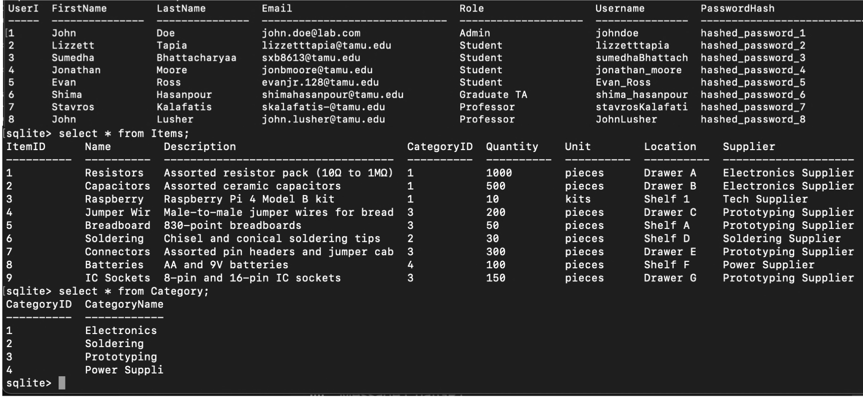
Subsystem Progress: Lizzett
Completed:
Explored the key differences between SQL and NoSQL databases
Looked into working with both databases: MongoDB and MySQL
However, I ran into issues with both
Transitioned to working with SQLite, a serverless SQL database
Created three local database tables: Users, Items, Categories
In Progress:
Establish a working hosting server to transition from the local SQLite to a server-based SQL database
Using:
SQLite

Slide 8
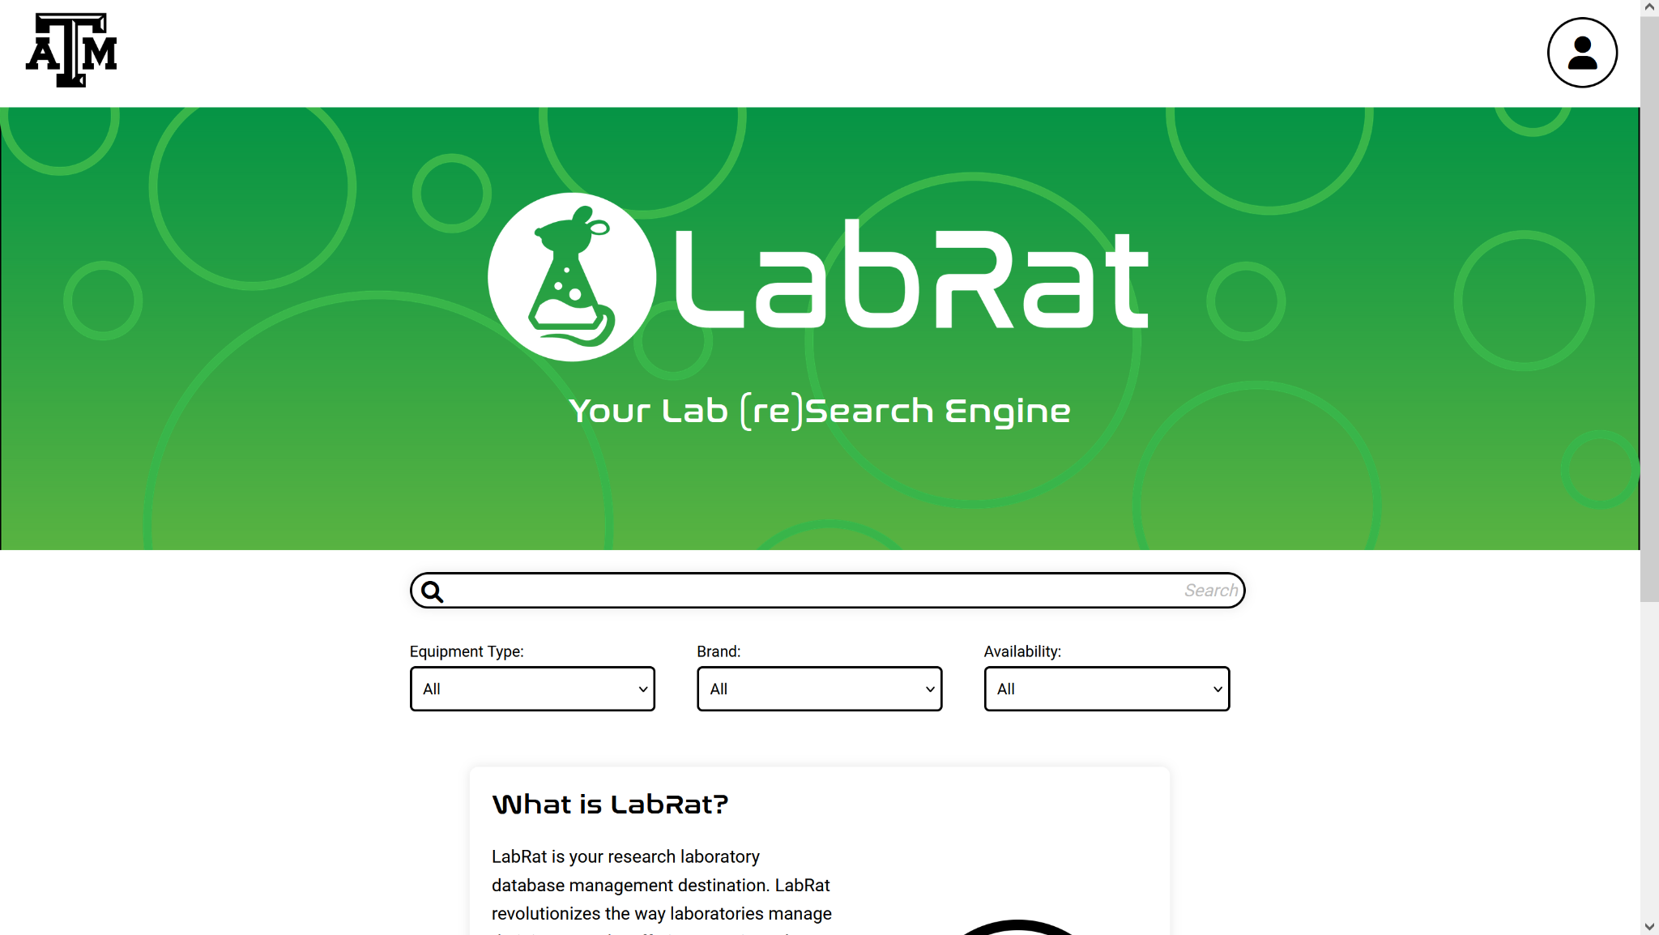
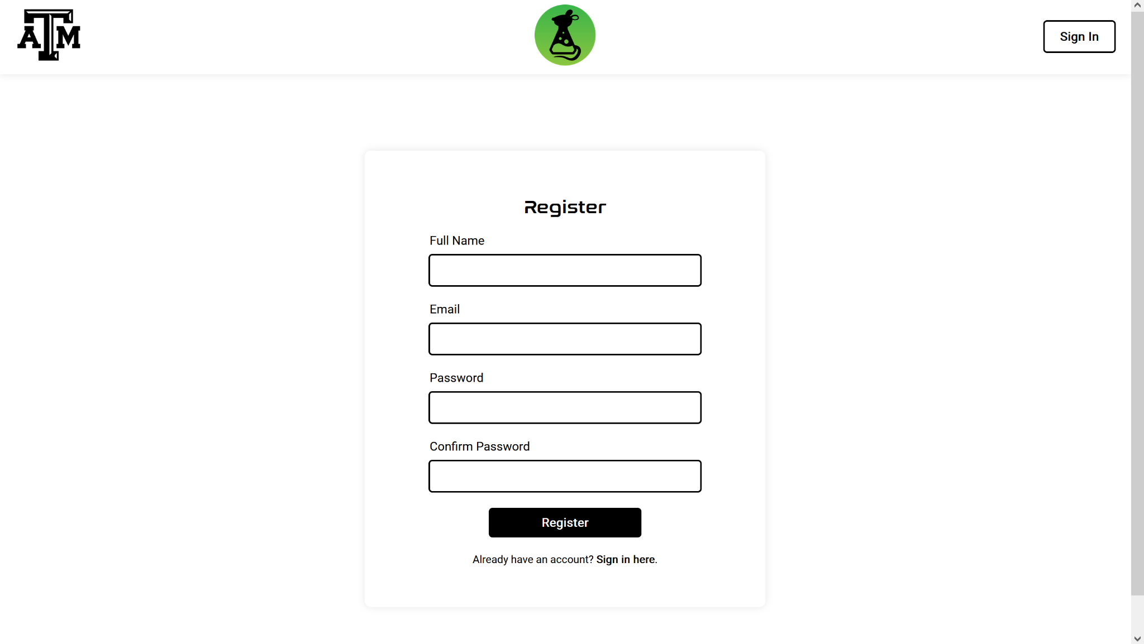
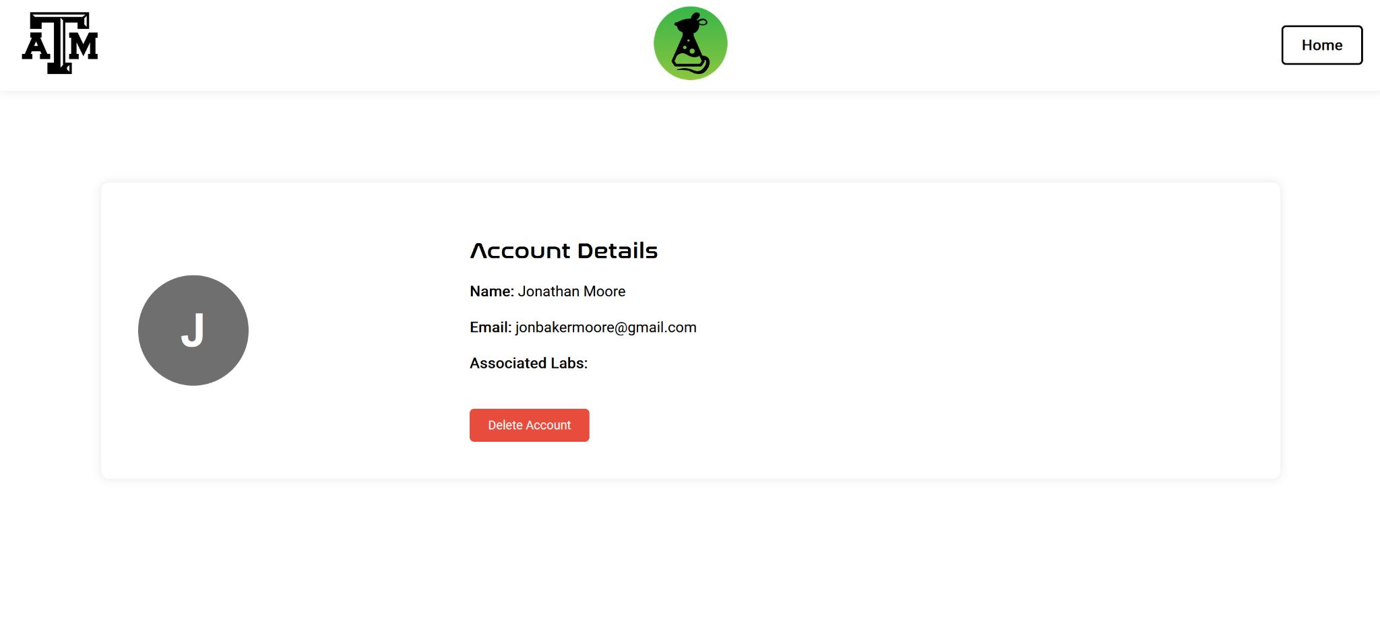
Subsystem Progress: Jonathan
Completed:
Home, Register, and Sign-in pages.
Server to host the pages locally.
Local database to test functionality.
In Progress:
Account page.
Search functionality.
Item check-out/check-in functionality.
Administrator and Professor permission levels and abilities.
What I am using:
Frontend: HTML, CSS, Javascript
Backend: Javascript, Node.js, SQLite

Slide 9
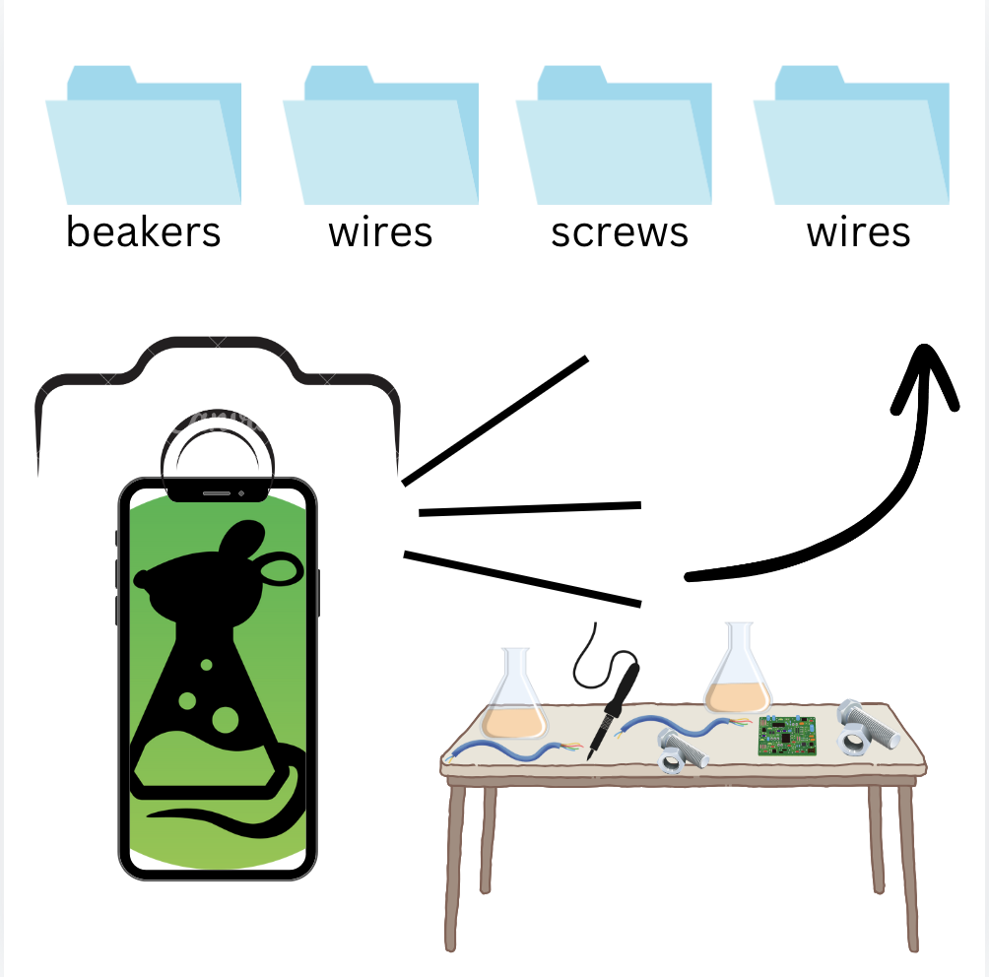
Subsystem Progress: Sumedha
Completed:
Adapted a pre - trained ML model
Created Dummy Data Set
In progress:
Create a function to automate the process of categorizing images
Start testing
Using :
VS Code, Python, ResNet50, Google Images

Slide 10

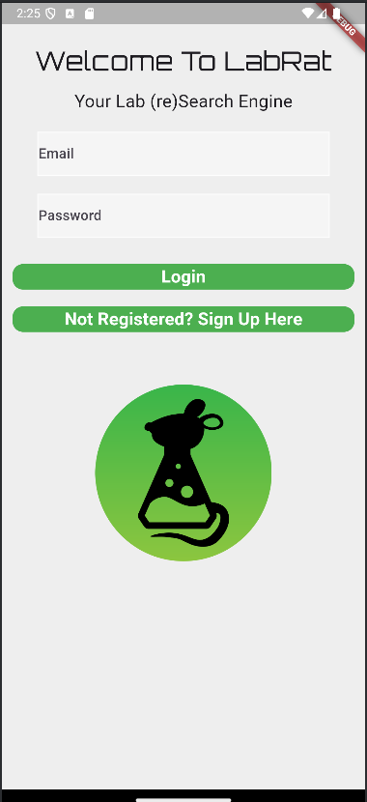

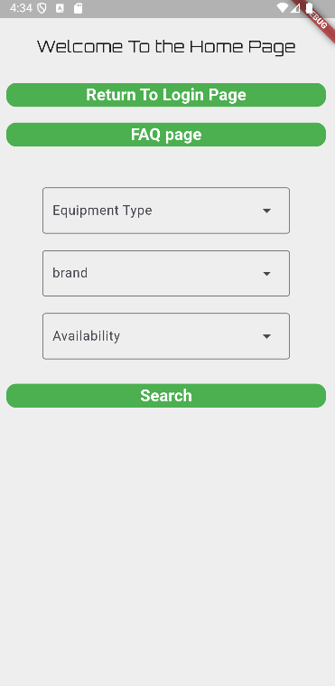
Subsystem Progress: Evan
Completed:
Created a basic UI for login screen, home screen, and registration page
Users can register with their email and password and login to access the app.
User information is stored in an sqlite database
In Progress:
Working on creating an example lab dataset, which can be displayed in the app UI
Search functionality
Using:
Developing for android phone
Android Studio with Flutter Plugin
sqflite

Slide 11
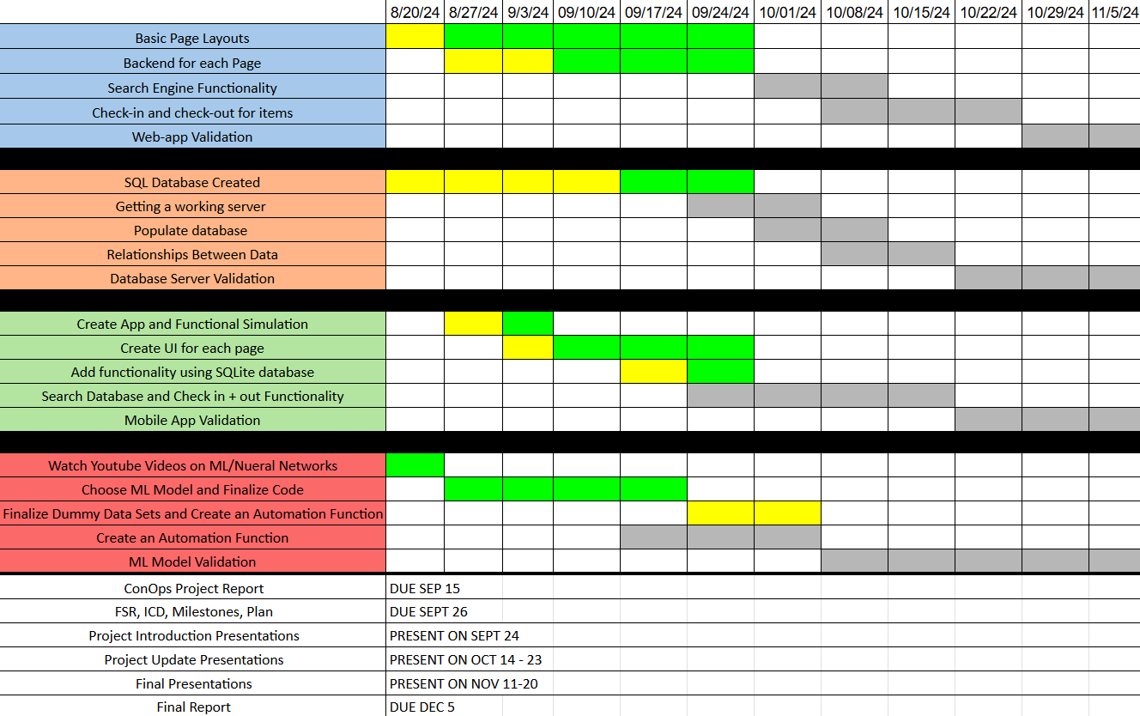
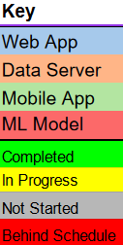
Execution Plan

Slide 12
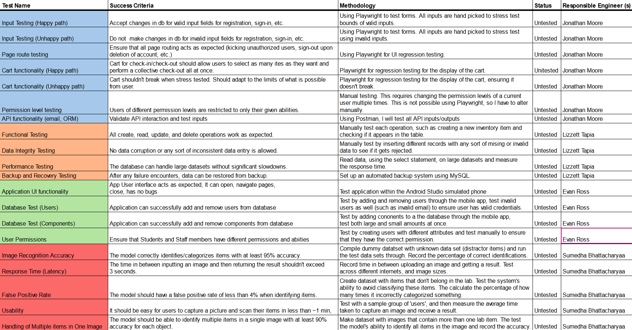
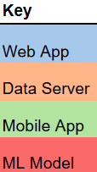
Validation Plan

